Slide 2
Exceptions
The Java programming language uses exceptions to handle errors and other exceptional events

Slide 3
What is an Exception?
The term exception is shorthand for the phrase "exceptional event."
An exception is an event, which occurs during the execution of a program, that disrupts the normal flow of the program's instructions

Slide 4
Division by Zero
Notice that several lines of information are displayed in response to this invalid division
This information is known as the stack trace, which includes the name of the exception (java.lang.ArithmeticException): / by zero in a descriptive message that indicates the problem that occurred and the complete method-call stack

Slide 5
Exception Object and throwing
When an error occurs within a method, the method creates an object and hands it off to the runtime system
This object is called an exception object
Exception object contains information about the error,(type and the state of the program when the error occurred)
Creating an exception object and handing it to the runtime system is called throwing an exception.

Slide 6
The Catch or Specify Requirement
The code that might throw certain exceptions must be enclosed by:
A try block that catches the exception
A method that provides a throws clause that lists the exception

Slide 7
Kinds of Exception
The first kind of exception is the checked exception.
Suppose a user supplies the name of a nonexistent file, hence the constructor throws java.io.FileNotFoundException
Checked exceptions are subject to the Catch or Specify Requirement

Slide 8
Kinds of Exception
The second kind of exception is the error
These are exceptional conditions that are external to the application
For example, suppose that an application successfully opens a file for input, but is unable to read the file because of a hardware or system malfunction
The unsuccessful read will throw java.io.IOError
Errors are not subject to the Catch or Specify Requirement

Slide 9
Kinds of Exception
The third kind of exception is the runtime exception
These are exceptional conditions that are internal to the application
For example, consider the application described previously that passes a file name to the constructor for FileReader. If a logic error causes a null to be passed to the constructor, the constructor will throw NullPointerException
Runtime exceptions are not subject to the Catch or Specify Requirement
Errors and runtime exceptions are collectively known as unchecked exceptions

Slide 10
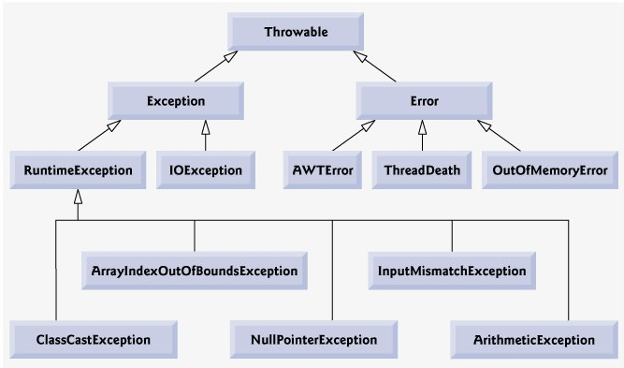

Slide 11
Catching and Handling Exceptions
How to use the three exception handler components
The try block
The catch block
The finally block

Slide 12
Try Block
The first step in constructing an exception handler is to enclose the code that might throw an exception within a try block
In general, a try block looks like the following
try { code } catch and finally blocks . . .

Slide 13
The Catch Blocks
Exception handlers are associated with a try block by one or more catch blocks directly after the try block
No code can be between the end of the try block and the beginning of the first catch block
try { . . . }
catch (ExceptionType name) { . . . }
catch (ExceptionType name) { . . . }

Slide 14
Try and Catch Block
try {
} catch (FileNotFoundException e) { System.err.println("FileNotFoundException: " + e.getMessage()); throw new SampleException(e);
} catch (IOException e) { System.err.println("Caught IOException: " + e.getMessage());
}

Slide 15
The finally block
The finally block always executes when the try block exits
This ensures that the finally block is executed even if an unexpected exception occurs.
Finally is useful for more than just exception handling
finally {
if (out != null) { System.out.println("Closing PrintWriter"); out.close(); }
else { System.out.println("PrintWriter not open"); } }

Slide 16
Putting all together
public void writeList() {
PrintWriter out = null;
try { System.out.println("Entering try statement");
out = new PrintWriter( new FileWriter("OutFile.txt"));
for (int i = 0; i < SIZE; i++)
out.println("Value at: " + i + " = " + vector.elementAt(i));
} catch (ArrayIndexOutOfBoundsException e) { System.err.println("Caught " + "ArrayIndexOutOfBoundsException: " + e.getMessage());
} catch (IOException e) { System.err.println("Caught IOException: " + e.getMessage());
} finally { if (out != null) { System.out.println("Closing PrintWriter"); out.close(); } else { System.out.println("PrintWriter not open"); } } }

Slide 17
Stack Unwinding
When an exception is thrown but not caught in a particular scope, the method-call stack is "unwound," and an attempt is made to catch the exception in the next outer try block
This process is called stack unwinding
If a TRY block encloses that statement, an attempt is made to catch the exception
If a try block does not enclose that statement, stack unwinding occurs again
If no catch block ever catches this exception and the exception is checked (as in the following example), compiling the program will result in an error.

Slide 18
How to Throw Exceptions
Before you can catch an exception, some code somewhere must throw one
Any code can throw an exception:
your code
code from a package written by someone else
packages that come with the Java platform (JRE)
Regardless of what throws the exception, it's always thrown with the throw statement

Slide 19
Throwable class
The Java platform provides numerous exception classes
All the classes are descendants of the Throwable class, and all allow programs to differentiate among the various types of exceptions that can occur during the execution of a program

Slide 20
The throw statement
All methods use the throw statement to throw an exception
The throw statement requires a single argument: a throwable object
throw someThrowableObject;
Example on next slilde

Slide 21
public Object pop() {
Object obj;
if (size == 0) {
throw new EmptyStackException(); }
obj = objectAt(size - 1);
setObjectAt(size - 1, null); size--; return obj; }
Here pop instantiates a new EmptyStackException object (a member of java.util) and throws it

Slide 22
Preconditions and Post conditions
A method's precondition is a condition that must be true when the method is invoked
Preconditions describe method parameters and any other expectations the method has about the current state of a program.
A method's postcondition of a method is a condition that is true after the method successfully returns
Postconditions describe the return value and any other side-effects the method may have
These conditons are called Assertions.

